Slide 1
What is the best BEER?
Unit 9 Case Study of Breweries
Morgan Nelson
Michael Hedge

Slide 2
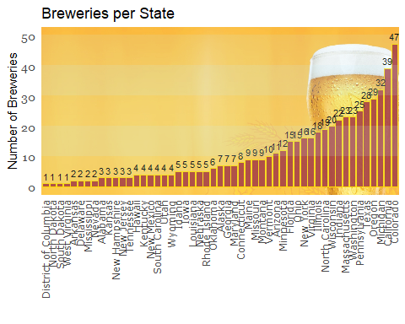
How many breweries per state
Colorado has most breweries with 47
States with only 1 brewery
DC, N. Dakota, South Dakato, W. Virginia

Slide 3
Missing data

Slide 4
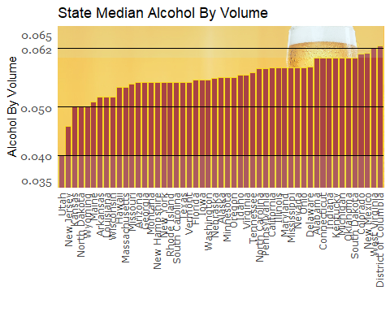
Median ABV per state
DC has highest median ABV 0.065 with W. Virginia next with 0.062
Utah has lowest median ABV at 0.040

Slide 5
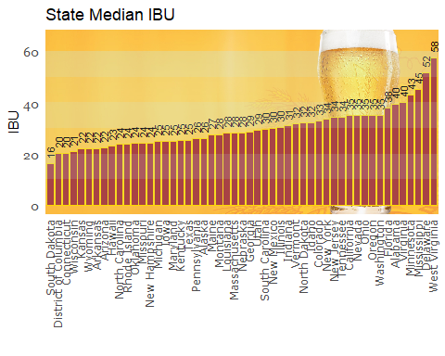
Median IBU per state
W. Virginia has highest median IBU at 58, Delaware is next with 52
S. Dakota has lowest median IBU at 16

Slide 6
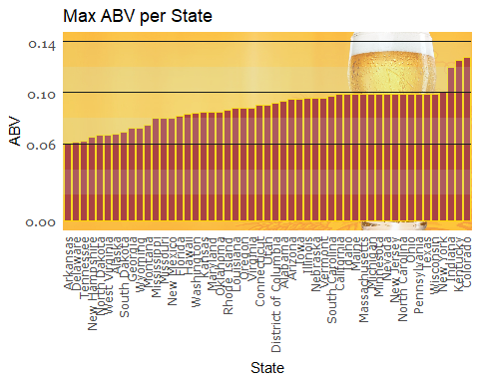
Max ABV
Colorado has highest ABV 0.136 with Kentucky next with 0.135
Arkansas has lowest ABV at 0.006

Slide 7
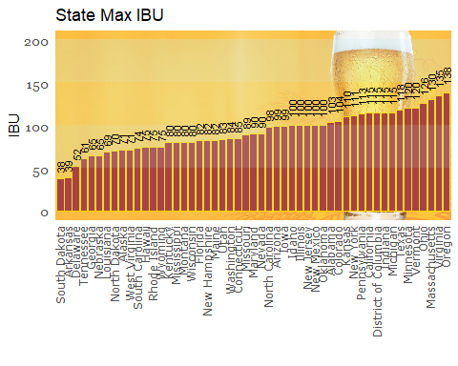
Max IBU
Oregon has max IBU of 138
S. Dakota has min IBU of 38

Slide 8
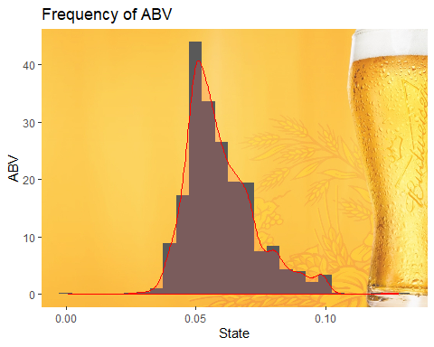
ABV stats and distribution

Slide 9
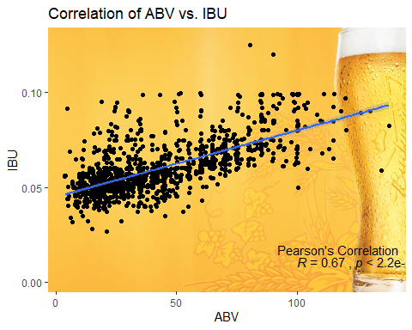
ABV to IBU
Original data has correlation of 67%

Slide 10
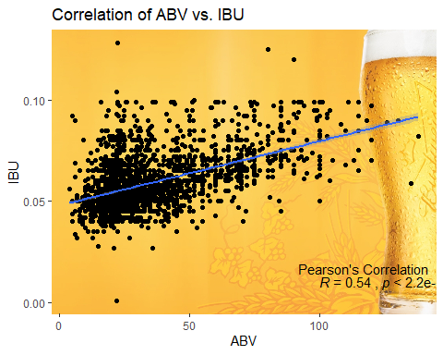
ABV to IBU
Filled data has correlation of 54% which is due to large cluster of filled data below 50 ABV

Slide 11
Future?
Sales data to correlate type of beers with sales by state.
More complete data set for better analysis.

